Slide 1
Flying IoT: Toward Low-Power Vision in the Sky
Guided By,
GREESHMA T R
ASST.PROFESSER
MDIT ULLIYERI
MANULAL M B
S8 CSE
ROLL NO:50

Slide 2
OVERVIEW

Slide 3
INTRODUCTION
Drones are an emerging form of new IoT devices, flying in the sky with full network connectivity capabilities.
Intelligent drones with cognitive computing skills need the capability to automatically recognize and track objects.
a cognitive drone platform Flying IoT, to quantify the power and performance characteristics of drone.

Slide 4
Continue..
An application called Follow the Leader, which automatically detects, tracks, and follows a moving human target.
The System is centered on a machine learning task called object detection.

Slide 5
PROBLEM STATEMENT
Object detection is a necessary step toward new and intelligent applications such as sports photography and package delivery.
Cognitive applications are often very computationally intensive, which makes them difficult to run on embedded computers.
The system needs low-power, lightweight, small-size design requirements.

Slide 6
LITERATURE SURVEY
A Survey on Sensor-Cloud: Architecture, Applications and Approaches
WASAI SHADAB ANSARI Chair of Mobile and Pervasive Computing, CoCIS, KSU Riyadh, KSA wansari@ksu.edu.sa
.ATIF M. ALAMRI Chair of Mobile and Pervasive Computing, CoCIS, KSU Riyadh, KSA atif@ksu.edu.sa

Slide 7
Sensors are capable of sensing the several appearances and can be utilized in several areas.
Where physical sensors are virtualized as virtual sensors on cloud computing by this infrastructure.
virtual sensors are provisioned automatically to end users whenever they required.

Slide 8
ADVANTAGES
With the sharing of sensors the acceleration as well as the services can be increased.
This infrastructure would provide the service instances (virtual sensors) automatically to users.
These service instances and its appropriate sensor data can be used via a user interface through the web.

Slide 9
DISADVANTAGES
The system is fully depends on the internet service.
Cloud storage limitations such as lack of storage space.
the system should have to offer different authorization roles for different types of users and authenticated via this web interface.
While using smart phone as a gateway, power (battery) is the main issue that has to be taken care

Slide 10
Internet of Things (IoT) based Sensors to Cloud system using ESP8266 and Arduino Due
Mr. Nerella Ome1, Master of Engineering, Assistant Professor, GRIET, Hyderabad, Telangana
Mr. G. Someswara Rao2, India1 M.Tech, Assistant Professor, VJIT, Hyderabad, Telangana, India2

Slide 11
The system is an advanced solution for monitoring the weather conditions at a particular place.
The system deals with monitoring and controlling the environmental conditions like temperature, humidity, light intensity and sound level with sensors.
The data updated from the implemented system can be accessible in the internet from anywhere in the world

Slide 12
ADVANTAGES
Sensors and devices transmit data directly to the Internet.
The smart way to monitor environment and an efficient.
This data will be helpful for future analysis and it can be easily shared to other end users.

Slide 13
DISADVANTAGES
This technology cannot be directly applied to drones
The connection wires as well as the processer when in applied to the drones the system becomes heavy and less efficient
High cost of implementation.

Slide 14
Flying Objects Detection from a Single Moving Camera
Artem Rozantseva Vincent Lepetit a ;b Pascal Fuaa aComputer Vision Laboratory, ´ Ecole Polytechnique F´ed´erale de Lausanne (EPFL)bInstitute for Computer Graphics and Vision, Graz University of Technology fartem.rozantsev, pascal.fuag@epfl.ch, lepetit@icg.tugraz.at

Slide 15
In the world of flying machines most of the progress is achieved in the accurate position estimation and navigation.
The system deals with controlling and monitoring data manually.
A software is designed for controlling the flying drone.

Slide 16
ADVANTAGES AND DISADVANTAGES
Very effective photo capturing and monitoring
Architecture of drone is efficient
Since the system controlled manually there is a chance of mistakes which are caused by human.
There is a greater chance of collision between two drones.

Slide 17
Towards Optimization of Energy Consumption of
Drones with Software-Based Flight Analysis
Ilenia Fronza, Nabil El Ioini, Aristea Ibershimi Free University of Bozen/Bolzano
Bolzano, Italy {ilenia.fronza, nabil.elioni, aristea.ibershimi}@unibz.it

Slide 18
The fast development and diffusion of the new generation of unmanned aerial vehicles, more popularly known as drones.
The capabilities of new generation drones boost a high demand of power that traditional batteries cannot sustain.
We outline a strategy to measure the energy consumption of commercial quad drones.
In this way, users may identify what are the maneuvers, movements and general aspects of the flight profile (load, altitude, speed).

Slide 19
ADVANTAGES AND DISADVANTAGES
With the help of application the system shows different parameters.
Software application is very user-friendly.
The system using rolling spider system.
The system needs to control by someone so man effort is necessary

Slide 20
Understanding Autonomous Drone Maneuverability for Internet of Things Applications
Azade Fotouhiy, Ming Dingy and Mahbub Hassany School of Computer Science and Engineering University of New South Wales (UNSW), Sydney, Australia Email: {a.fotouhi, mahbub.hassan}@unsw.edu.au yData61, CSIRO, Australia Email: {azade.fotouhi, ming.ding, mahbub.hassan}@data61.csiro.au

Slide 21
Increasing sensing and communication capabilities combined with falling prices have made drones very attractive for Internet of Things applications.
These developments have made drones a very attractive platform to launch many Internet of Things (IoT) applications.
In a smart city and transmit that data to an IoT server in real-time using LoRa or even 4G depending on the availability.

Slide 22
ADVANTAGES AND DISADVANTAGES
Low power consumption of drone.
The speed of the drone can be calculated.
Cognitive algorithms cannot be implemented in this system due to low processing quality.

Slide 23
WORKDONE
The system works automatically based on object detection and cognitive algorithms.
Sensor-cloud architecture reduces the energy consumed in the system.
With the help of follow the leader application the system can be used in sports photography.

Slide 24
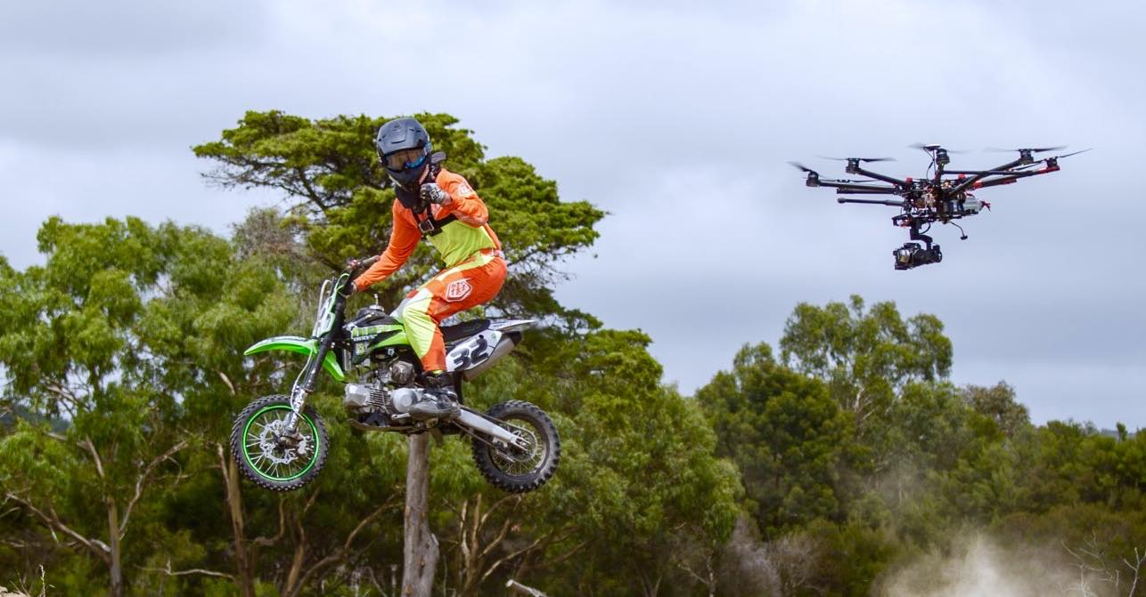
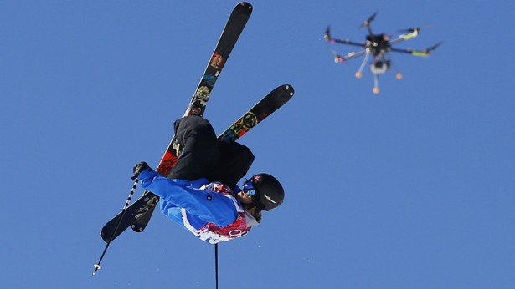

Slide 25
TECHNOLOGY USED
Object detection for avoid the collision between objects and drones.
The cloud server The system use is equipped with a 3.6 GHz processor and a GeForce GTX 1080 graphics card.
The system proposes a sensor-cloud system to bring server-level computational capability to low-power IoT devices.
Drone Computing Platform For a typical Flying IoT computing platform.

Slide 26
ADVANTAGES
The motor, sensors, controls used in the drones are highly efficient.
The data's are collected by the sensors are stored in the cloud server and from there it will decide how it should be worked.
The system uses the comparison of two processors such as tx1 and imx6, the power consumed is low.
Using of the cognitive algorithm the system gives high quality data processing
Here the drones also detect and follow moving human target in real time.

Slide 27
LIMITATIONS
Here the multiple human detection is less efficient.
The speed and performance of the system completely based on the network system.
The system needs good internet connectivity.
The implementation of the system is very difficult.

Slide 28
FUTURE ENHANCEMENT
It will be important to investigate the implications of network stability on drone applications that utilize the cloud.
The impact of 4G and future 5G networks on the speed and energy efficiency of drone applications.
Implementation of processor having low power consumption could increase the efficiency of the system.

Slide 29
CONCLUSION
The Internet of Things is using both cognitive capability and the ability to interact directly with their environments in real time.
With appropriate compression and down sampling optimizations, sensor-cloud architectures can reduce power consumption.
The system is a innovation for sports photography and packet delivery system.

Slide 30
BIBLIOGRAPHY
[1.] W.F. Domoney et al., “Smart City Solutions to Water Management using Self-Powered, Low-Cost, Water Sensors and Apache Spark Data Aggregation,” Proc. 3rd Int’l Renewable and Sustainable Energy Conf., 2015, pp. 1–4.
[2.] G. Demiris et al., “Senior Residents Perceived Need of and Preferences for Smart Home Sensor Technologies,” Int’l J. Technology Assessment in Health Care, vol. 24, no. 1, 2008, pp. 120–124.
[3.] H.-C. Chen et al., “Saliency-Aware Food Image Segmentation for Personal Dietary Assessment using a Wearable Computer,” Measurement Science and Technology, vol. 26, no. 2, 2015, p. 025702.

